Slide 1

“A Data Analyst's Journey Through NHS :
"Stories Behind the Numbers:
Stakeholder insights “
Venkat Potamsetti
Notes:
Good morning, everyone. Today, I have the privilege of taking you through a narrative that unfolds from the data I have gathered about the NHS. Our guiding star has always been to offer top-notch care, and my goal is to transform that vision into tangible actions by suggesting ways to enhance how individuals access services. Let's delve into a tale where Mrs. Jane Bloggs plays a central role.

Slide 2




NHS England Digital
#Context
Health and Social Care Secretary Steve Barclay said :
“We promised to prioritise patients and improve access and that is exactly what we have done” – and this is just the start.
“I am determined to make it easier for people to get an appointment with their GP practice when they need one and this will allow patients to make a more informed choice about the care they receive.”
Organizational Readiness :
Commitment to improve the quality of general practice appointment data.
Committed to working with the profession to improve the utility of the data.
Ensure continual refinements that benefit both individual practices and the wider service planning agenda.
The Rt Hon Steve Barclay MP
Organisational preparedness
Notes:
In our talk today, I want to discuss something called organisational readiness. This idea shows how well people, their work methods, our systems, and the way we check performance all work together. Just having data isn't enough. We often need to change our culture, really commit to it, and plan our services more broadly. From what we can see on health and social care websites, there's a strong commitment to this.

Slide 3
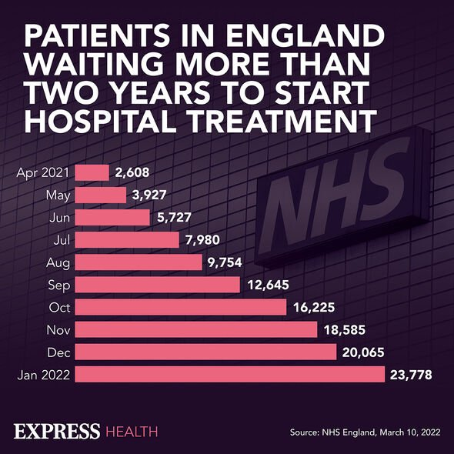



#Data is powerful
Dr. Sam: a doctor in a local general practice
Mrs Blogs: a patient waiting for appointment
NHS as an organisation
Notes:
Why are data or numbers so crucial for transformation? Data serves as a compelling means to present facts and engage a broader audience. Numbers often grab headlines because they provide clear, immediate insights, as you can see in this picture where it's evident that numbers are on the rise.
Now, let's weave these numbers into our story involving Sam, a dedicated doctor, Mrs. Boggs, a patient, and our NHS organization. Both Sam and the NHS are committed to delivering the best care possible to Mrs. Boggs. The intriguing question we face is: what's preventing them from achieving this goal? And more importantly, how can we navigate through these challenges to ensure a positive outcome for everyone involved?

Slide 4


#Waiting list
Mrs Blogs
Metrics
Known to GP
Face to Face appointment
With GP
No response since 2 weeks
Previous appointment has taken 4 weeks
Count of appointments
Time between booking and appointment
HCP type
Appointment months
ICB Locations
Actual duration
DNA
Service
Notes:
Let's take a step back and look at the bigger picture as we embark on our mission to assist Mrs. Blogs. Currently, Mrs. Blogs has been waiting for two weeks to see Sam, her general practitioner (GP). She prefers a face-to-face appointment, which she values greatly. The NHS, in its effort to identify and address the issue, has provided us with a wealth of data for our investigation.
Upon examining the provided data sets more closely, certain metrics stand out as particularly relevant to our quest. For instance, the data includes the count of appointments and Integrated Care Board (ICB) locations, among other details. These pieces of information could prove invaluable in our analysis, offering insights into the accessibility and distribution of services, which are crucial factors in improving Mrs. Blogs' experience and, by extension, the service quality of the NHS..

Slide 5



#Datasets
Data quality
Primary data source collected from GP systems
Data is collected from GP systems which are designed for practices to use in everyday work and not for the purpose of data analysis. Discrepancies
There are no national standards for data entry about activity, and there is widespread variation in approach to appointment management between practices. Lack of standardisation
actual_duration.csv
Issues with data collection prior , eg missing data from some practices using TPP System One system and practices using the Cegedim GP system are unable to supply appointment mode data. Missing data
appointments_regioal.csv
national_categories.csv
Notes:
In conducting an initial exploratory analysis, it's clear that while these data sets are invaluable for our investigation, they also come with limitations. These constraints are outlined in the metadata accompanying the data sets. By comparing this metadata with the insights gained from our preliminary exploratory analysis conducted using Python, we can better understand the boundaries within which we are operating.

Slide 6
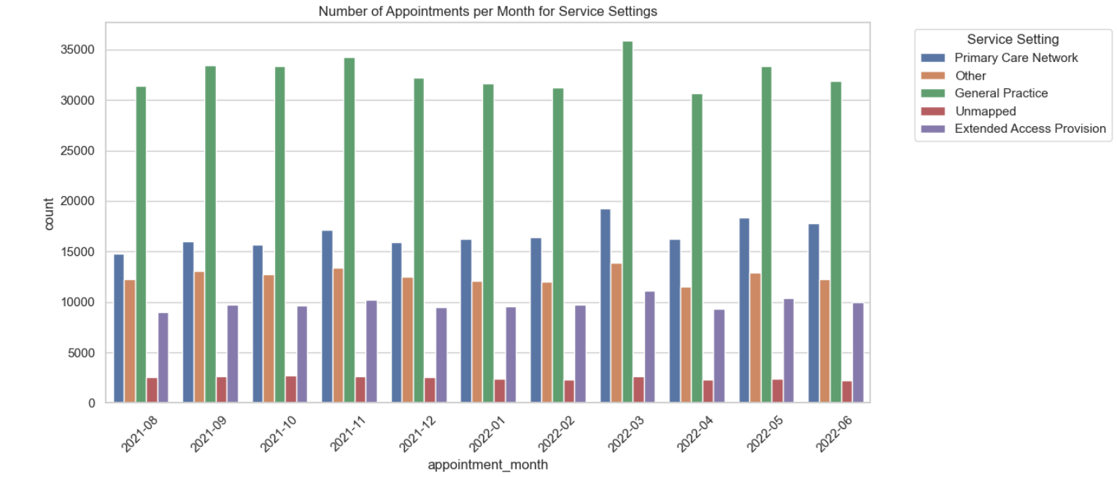
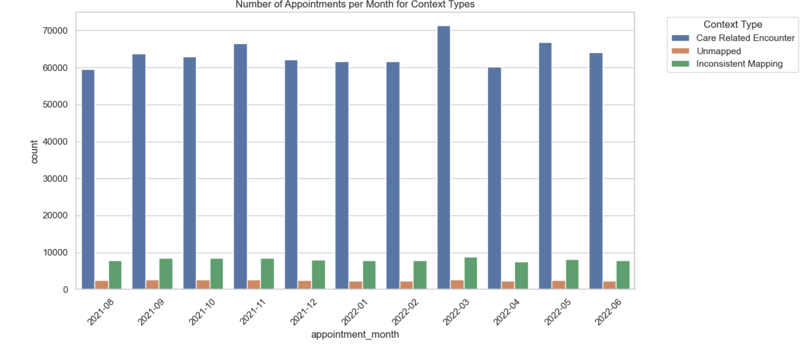
90 % GP
85 % Care Related
59% Face to Face
Winter, Autumn
Weekend
Summer
#Trends
Notes:
Trends in data analysis serve as a vital indicator of the direction or behavior of consumers or patients, as illustrated by this data set. Through the visualization of monthly appointments by service type, context (such as in-person or virtual consultations), and considering both seasonal variations and the insights from our exploratory analysis, we've identified specific trends related to appointment attendance.

Slide 7
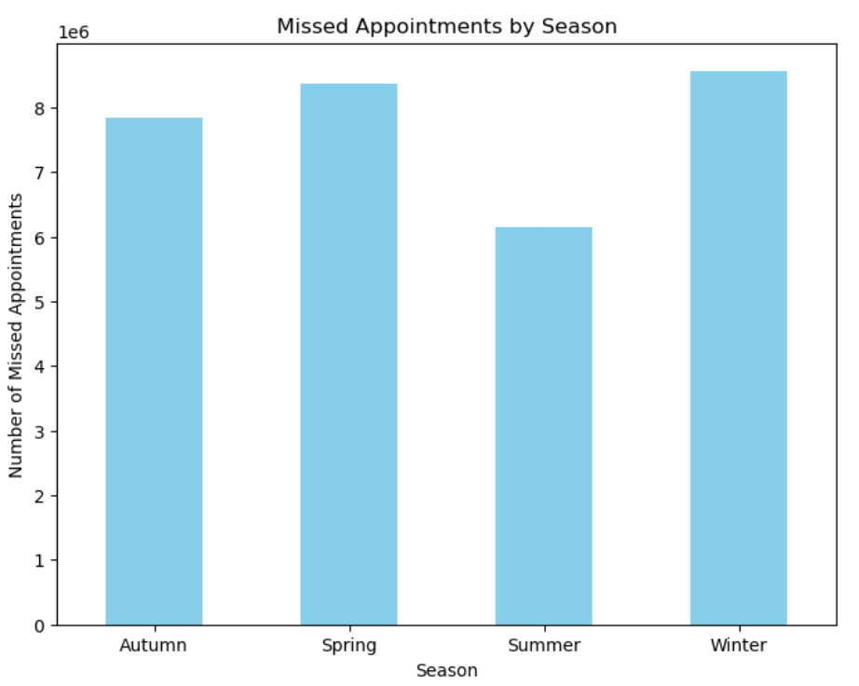
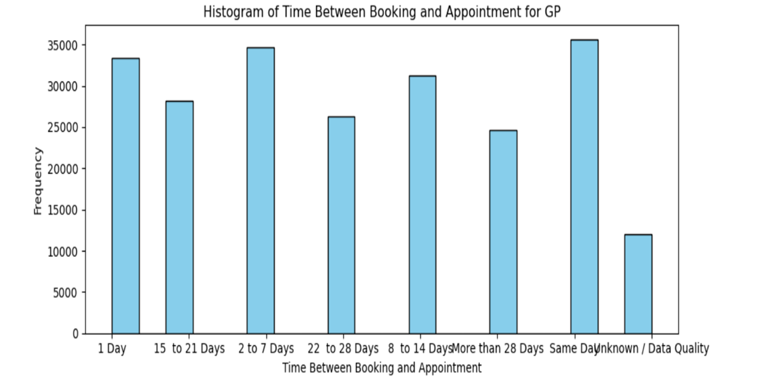
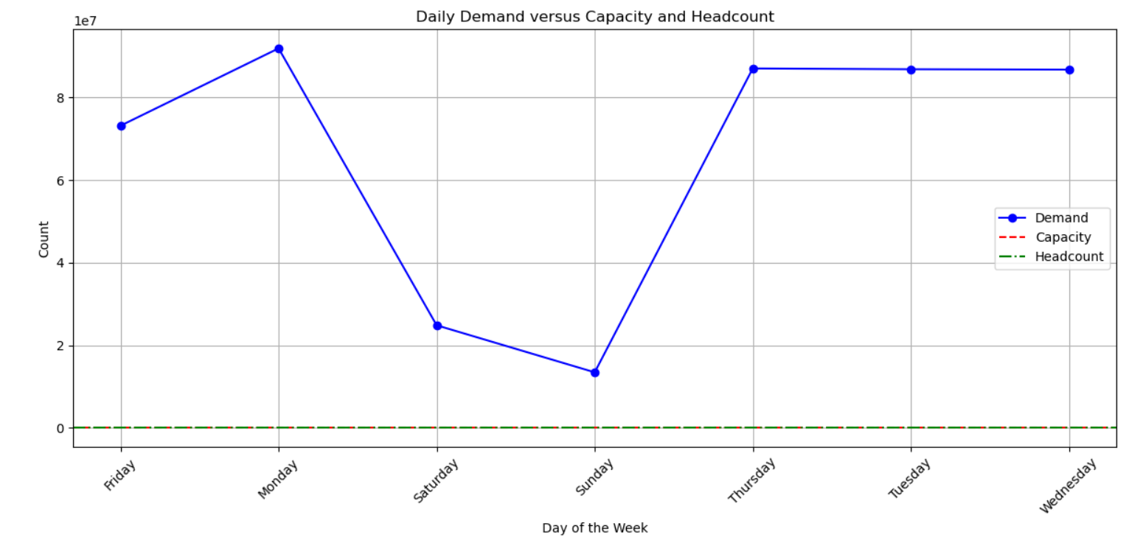
#Insights
Notes:
In our analysis, insights reveal significant patterns. For instance, during winter, many GP appointments are missed or postponed, indicating a potential decrease in utility. Additionally, weekends show lower demand, presenting an opportunity to address appointments waiting beyond 28 days and mitigate backlog risks, as per the British Medical Association's guidelines.

Slide 8
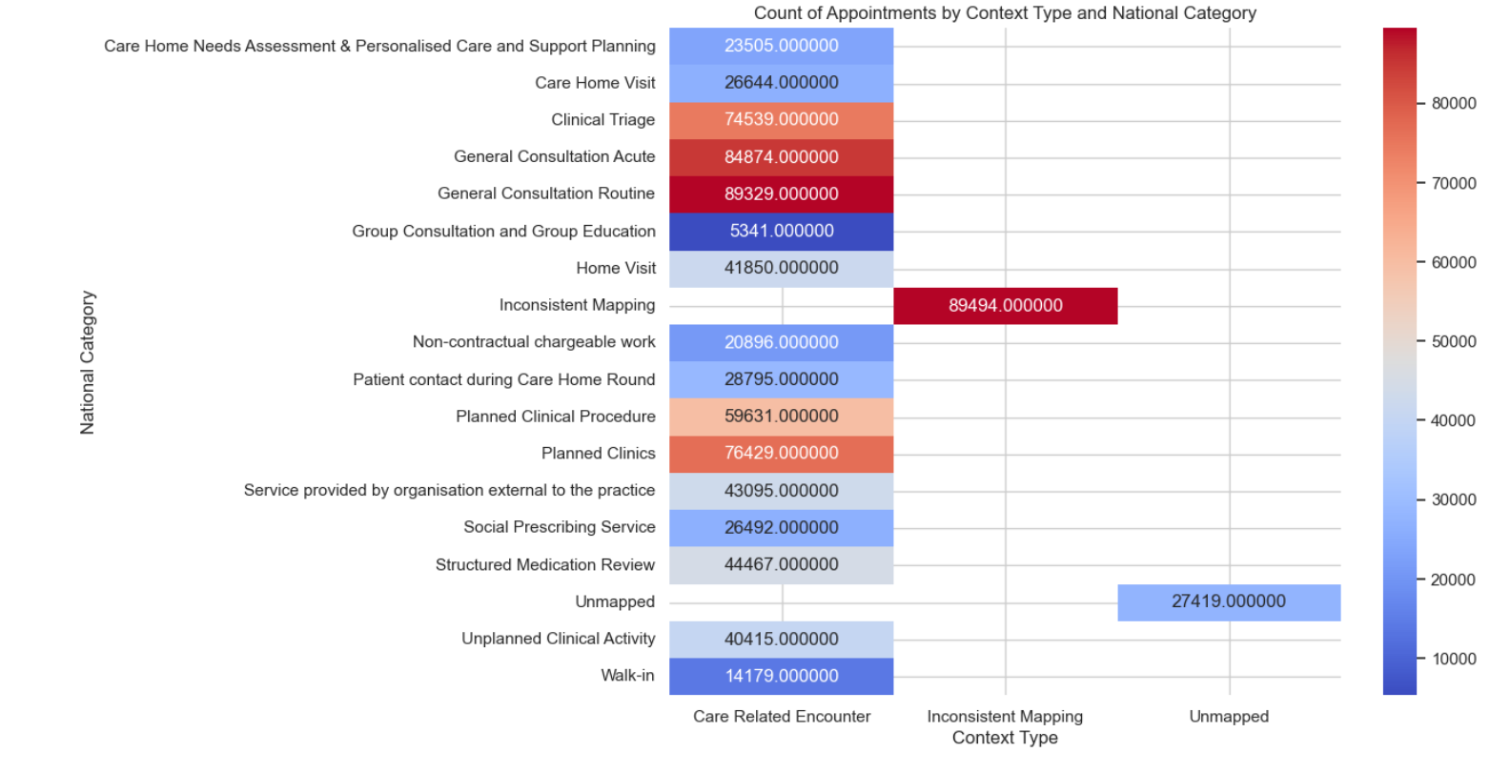
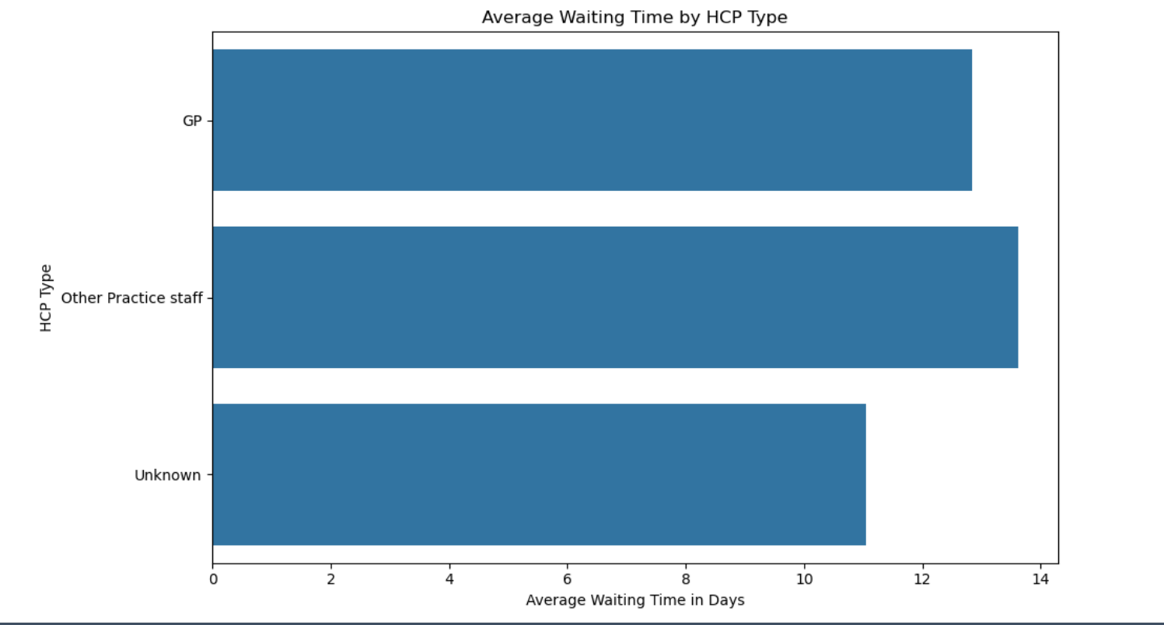
# insights
89494 - Inconsistant mapping
14 days – Average
Notes:
Further insights indicate that the highest number of appointments falls under the category of inconsistent mapping, which, according to metadata, are non-care-related encounters. This suggests that a significant portion of the workload is non-care-related, impacting overall efficiency. The average waiting time is just under 14 days, which means reducing this caseload requires addressing a waiting list equivalent to 7,000 appointments, with an average of 500 appointments per day calculated using Python code.
Having a waiting list isn't necessarily negative, as it reflects service demand and offers flexibility. However, further exploration is necessary to understand appointment durations and reasons for missed appointments to formulate effective recommendations.

Slide 9
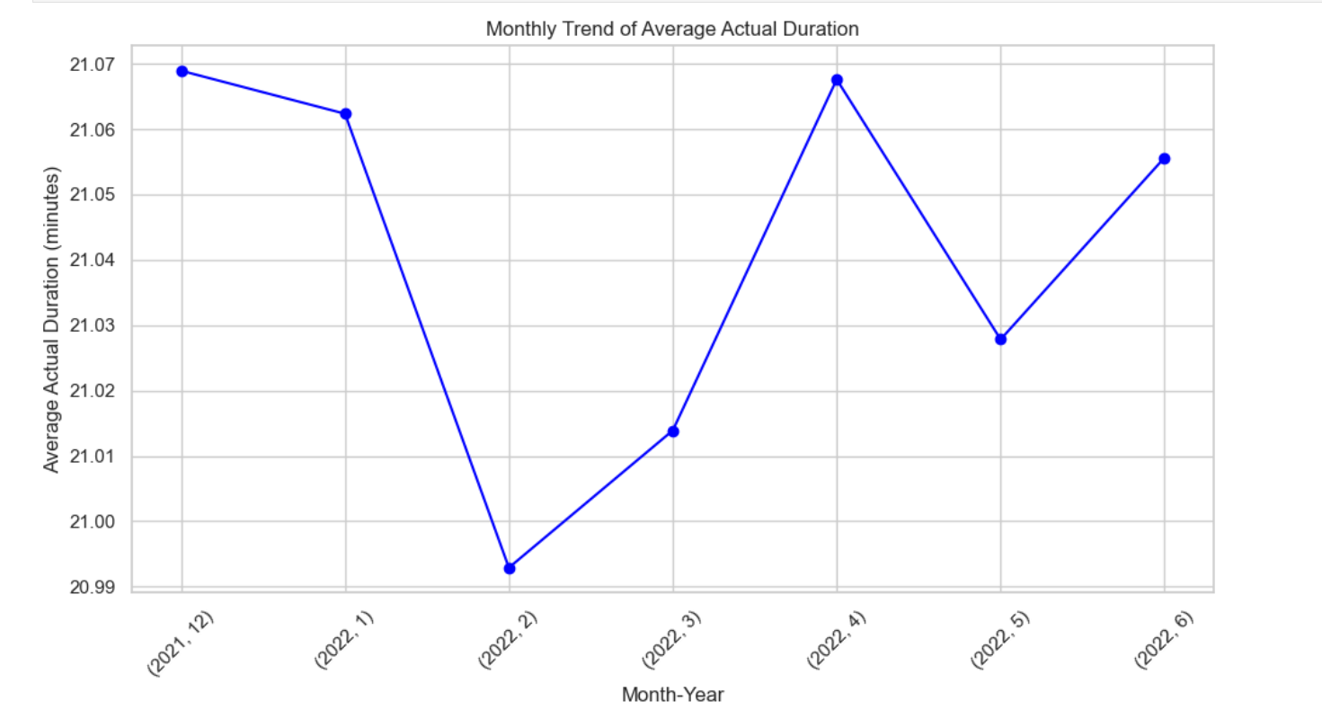
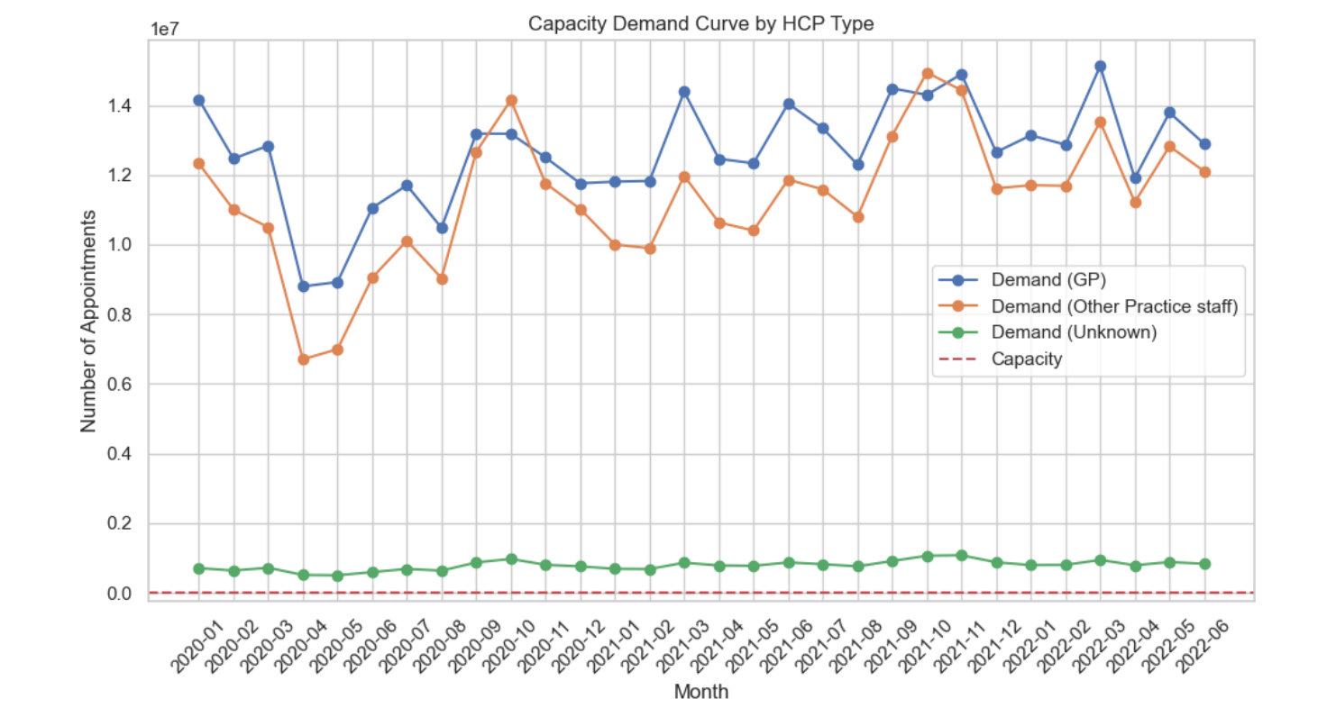
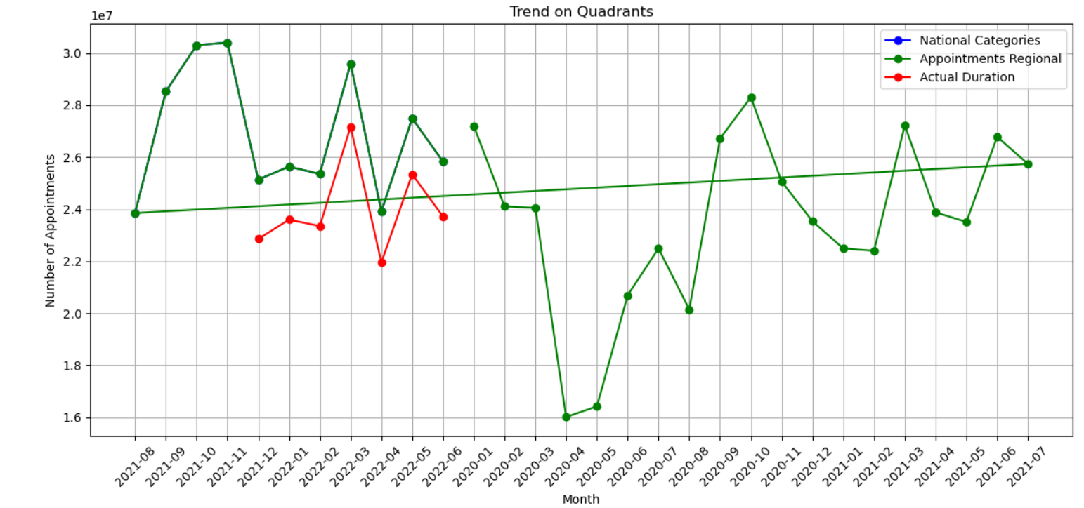
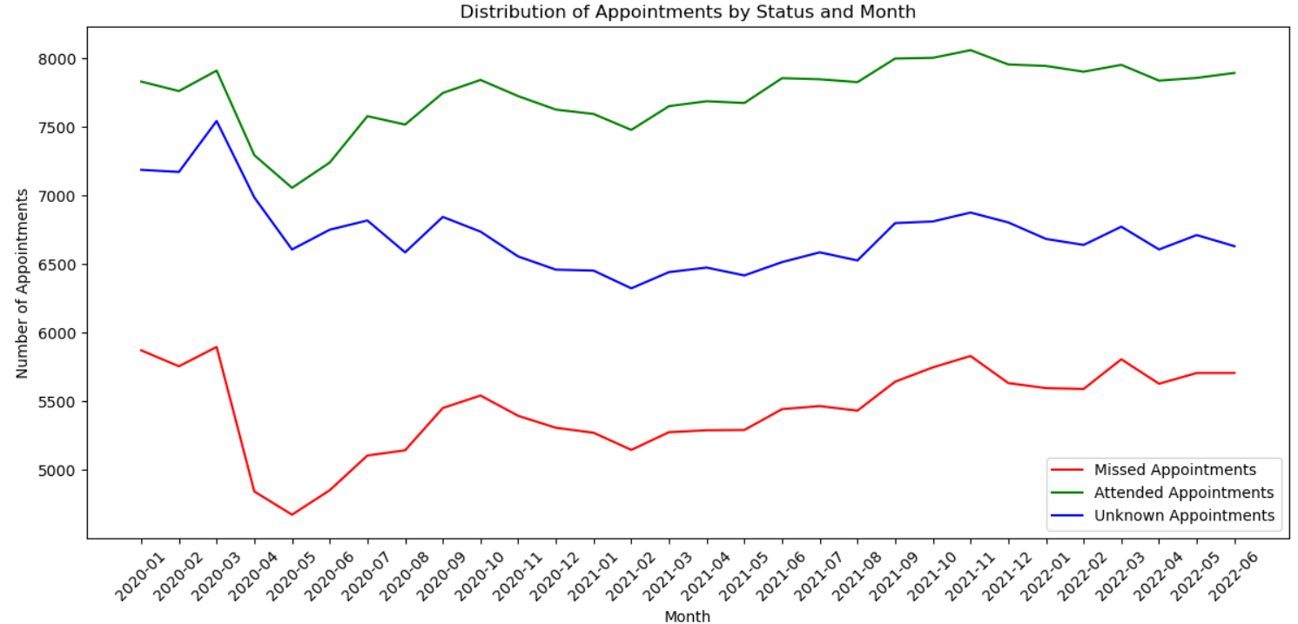
#patterns
Q3 Q4
Notes:
Patterns identified include a slight increase in the average duration of appointments in Q3 and Q4, suggesting a rise in face-to-face consultations. Although there's a sudden dip in 2020, overall trends in the quadrants indicate an upward trajectory, albeit with non-sequential dates making further interpretations challenging. Demand for GP appointments has remained consistent. However, the gap between attended and missed appointments has widened, possibly indicating an improvement in utilisation behavior.

Slide 10
# Recommendations
1) Enhance Appointment Management:
Implement systems to reduce missed or postponed appointments, especially during high-demand periods like winter.
2) Utilise Weekend Capacity:
Utilise weekends to address appointment backlogs and reduce waiting times, leveraging periods of lower demand.
3) Review Non-Care-Related Encounters:
Investigate and address the high number of non-care-related encounters to streamline workload and enhance efficiency.
Notes:
Explore strategies to optimise appointment durations while maintaining quality of care.

Slide 11
# Recommendations
4) Improve Data Organisation and Accessibility:
Organise data in a more coherent and chronological manner to facilitate easier interpretation and decision-making.
5) Enhance Patient Engagement:
Implement targeted patient engagement initiatives to encourage attendance and reduce the gap between attended and missed appointments.
6) Continuous Monitoring and Evaluation:
Establish a system for ongoing monitoring and evaluation of appointment trends and patient behaviour to inform continuous improvement efforts.

Slide 12





Receive
Enter into system
Complete booking
Check
Option
Yes/
No
Refuse
Face to face ?
Check needs eg hcp type?
Check service inventory

Slide 13


What makes Sam happy ?
Work life balance
What makes Mrs. Blogs happy ?
Quality care
What makes NHS organisation happy ?
Service Excellence
SAM
BLOGS
data
NHS
We all love a happy ending
Notes:
One aspect provided by data analysis for Sam, Mrs. Blogs, and the NHS from the above context is the identification of patterns and trends in appointment scheduling, attendance, and duration.By leveraging these insights, Sam can better manage his schedule, Mrs. Blogs can receive timely care tailored to her preferences, and the NHS can enhance service delivery and patient satisfaction.

